Slide 1
The Effects of SARS-CoV-2 infection on Cognitive and Brain Function
Josefina Weinerova
Josefina.Weinerova@Nottingham.ac.uk
Twitter: @JWeinerova

Slide 2
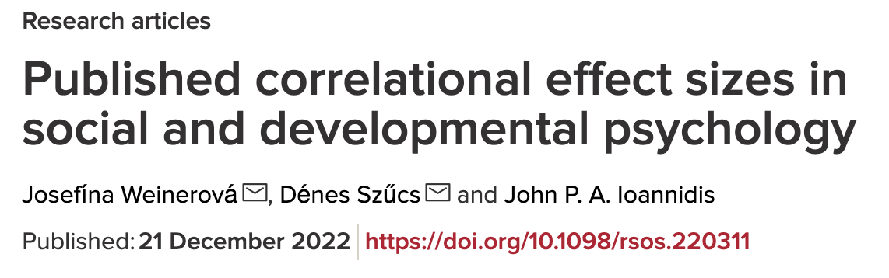
Previous work
Statistical power in neuroimaging research (undergraduate thesis, University of Cambridge)
The distribution of published effect sizes in social and developmental psychology (MPhil thesis with Dr Denes Szucs, University of Cambridge)

Slide 3
Reproducible ways in my PhD
Preregistration posters
PCI Registered Reports
Preregistrations
Replication
Verification of previous findings
Power calculation (even for secondary data analyses)
Open code (once we are finished)

Slide 4
Covid-19 and cognition
10-30% of non-hospitalized cases of SARS-CoV-2 infection are estimated to suffer from some symptoms that are ongoing for more than 3 months (Bull-Otterson et al., 2022, Ceban et al.,2022)
Up to 50% of those with ongoing symptoms also report having problems with memory, cognition and concentration (Dennis et al.,2023)
An association between cognitive problems and brain imaging has been found across different modalities (Zhao et al., 2023).
Reduced hippocampal neurogenesis found in mouse and hamster models of Covid-19 as well as in human samples (Fernandez-Castaneda et al.,2022; Soung et al., 2022).

Slide 5
Covid and Cognition Study (COVCOG) - Wave 1
Data collected by Cambridge Cognition and Motivated Behaviour Lab (CambLab)
Guo et al. (2022)
Online data collection
Found significant negative influence of past Covid-19 infection on long-term memory
Used 2 tests of long-term memory

Slide 6
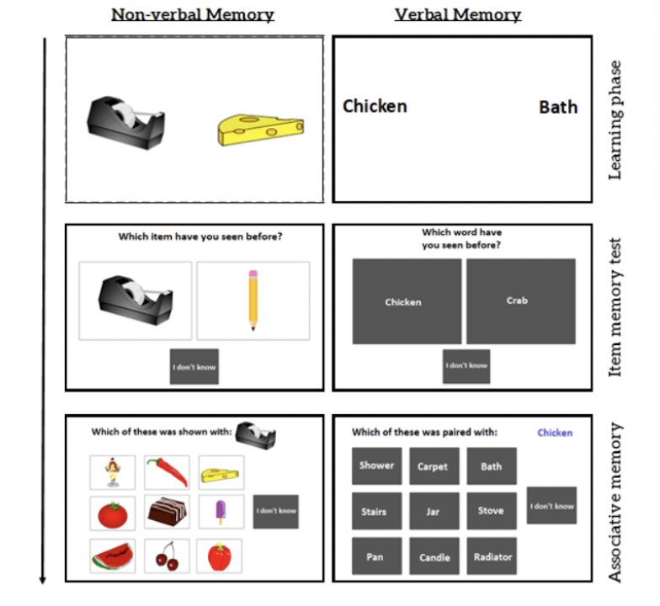
COVCOG – Wave 2 data
PROJECT 1
Secondary data analysis
PCI Registered Report
Aims:
Replication of analysis of memory tasks in Guo et al. (2022).
Extend analysis to newly added long-term memory tasks.
Analyse the effect of vaccination.

Slide 7
UK Biobank Covid-19 case control dataset
PROJECT 2
N=2092 (46-81 years)
Two testing instances: 2014 -> start of pandemic and 2021
Additional control group (N=2360, 49-82 years) tested both times pre-pandemic
Cognitive tests:
TMT A & B
Associative memory test
Fluid Intelligence test
Numeric memory
Reaction Time test
Picture Vocabulary test
Tower test
Symbol digit test
Matrix completion
Neuroimaging
MRI
rs-fMRI
DWI

Slide 8
UK Biobank Covid-19 case control dataset
PROJECT 2
Aims:
Replicate findings previously reported for subset of the data (Douaud et al., 2022).
Extend analysis to other cognitive tests and imaging modalities.
Currently working on the preregistration

Slide 9
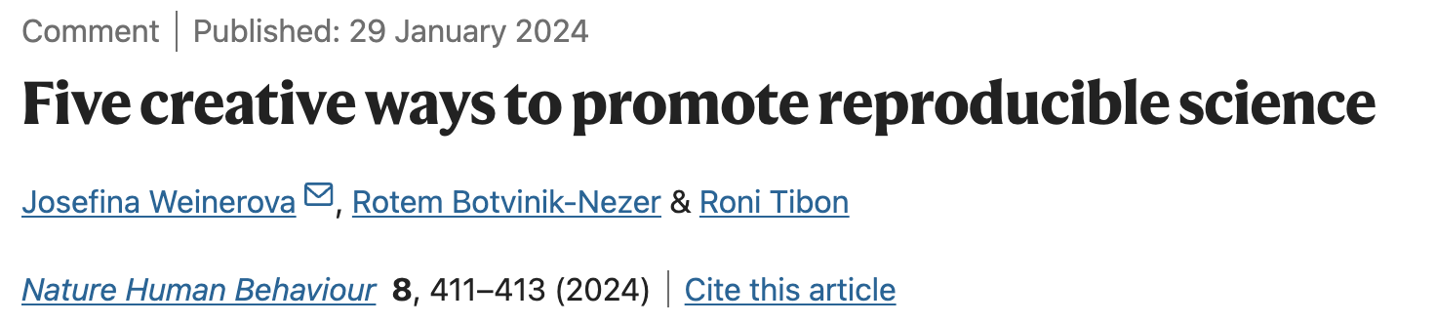

PROJECT 0
Funded project extensions to postgraduate students against evidence of engagement in reproducible practices.
Guaranteed funding for Registered Reports.
A reproducible science centralized knowledge base and helpline by discipline.
Institutional or departmental contact point for reproducible research practices.
Creating and maintaining reproducible science portfolio.

Slide 10
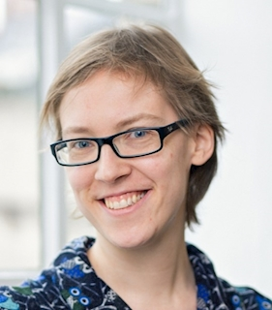
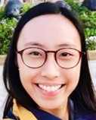
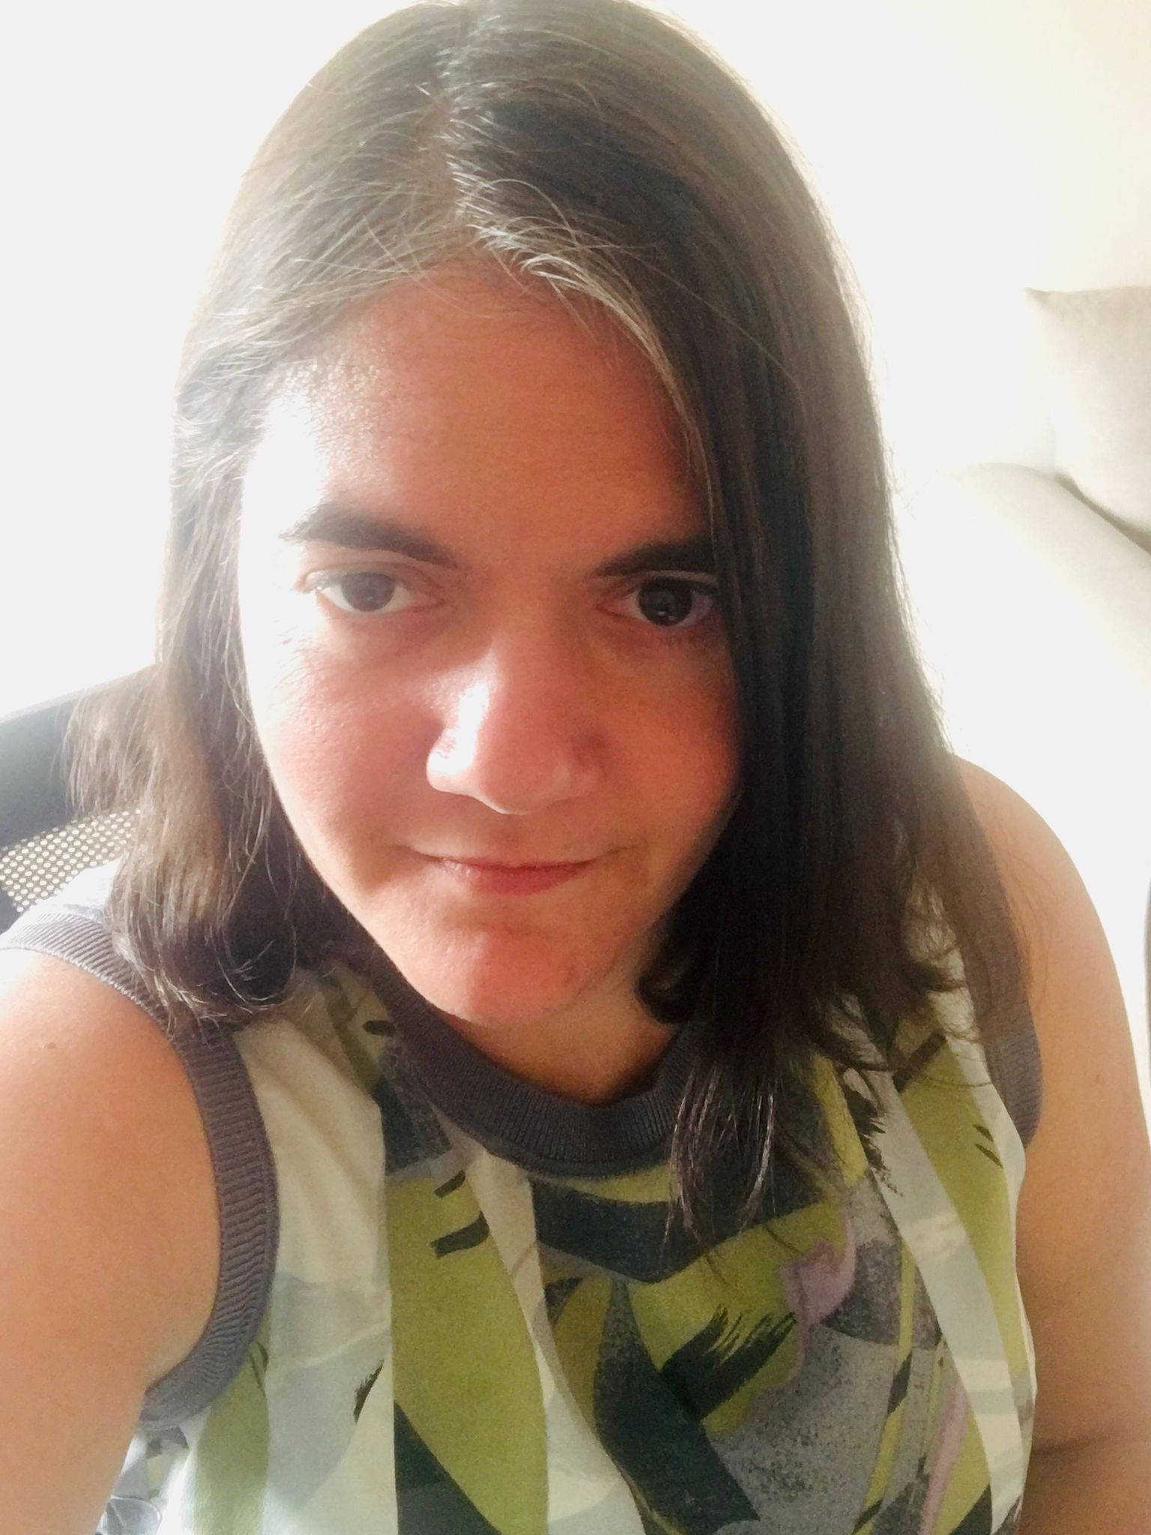
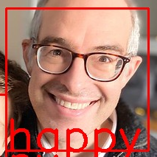
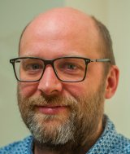
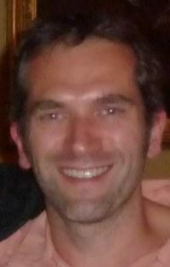
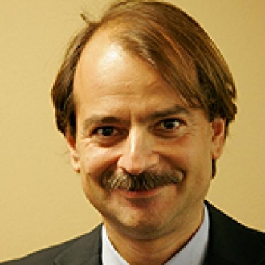
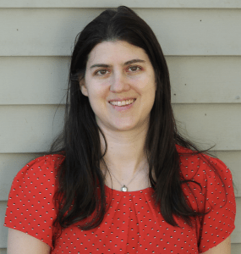
Acknowledgments
CambLab
My supervisors
Lucy Cheke
Sabine Yeung
Other projects
Roni Tibon
Denis Schluppeck
Andrew Reid
Denes Szucs
John Ioannidis
Rotem Botvinik-Nezer

